Slide 1



Objectives
  In this session, you will learn to:
    Create applications using the PreparedStatement object
    Manage database transactions
    Perform batch updates
    Create and call stored procedures in JDBC
    Use metadata in JDBC

Slide 2
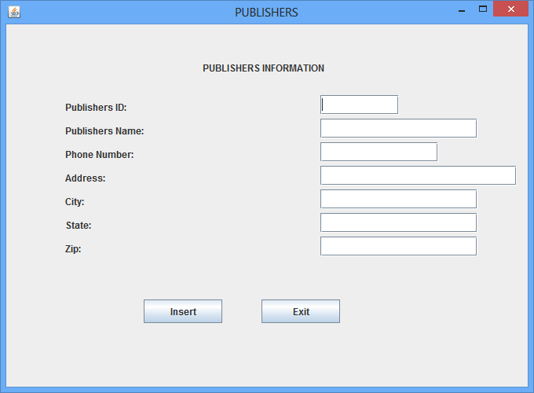
Activity 10.1: Creating an Application that Uses the PreparedStatement Object
  Problem Statement:
    The management of City library has decided to computerize the book inventory. The library management has assigned the preceding task to a leading software development company of the US. The Lead Analyst has assigned the development of the Book Inventory application to Mark, the Senior Software Developer. However, in the initial phase, Mark has decided to create an interface that will allow a user to add the details of a new publisher to the publishers table, as shown in the following figure.

Slide 3
Activity 10.1: Creating an Application that Uses the PreparedStatement Object (Contd.)
  Problem Statement (Contd.):
    Help Mark to achieve the preceding requirement.

Slide 4
Activity 10.1: Creating an Application that Uses the PreparedStatement Object (Contd.)
  Solution: To perform the activity, refer the steps given in the embedded document.

Slide 5
Managing Database Transactions
  A transaction:
    Is a set of one or more SQL statements that are executed as a single unit.
    Is complete only when all the SQL statements in a transaction execute successfully.
    Maintains consistency of data in a database.
  JDBC API provides the support for transaction management.
  The database transactions can be committed in two ways:
    Implicit
    Explicit

Slide 6
Committing a Transaction
  You need to explicitly call the commit() method to reflect the changes made by the transactions.
  The rollback() method is used to undo the changes made in the database after the last commit operation.
  When the rollback() method is invoked:
    All the pending transactions of a database are cancelled.
    The database gets reverted to the state in which it was committed previously.
  Consider the code given in the embedded document to create a transaction:

Slide 7
Just a minute
  How can you commit a transaction explicitly?

Slide 8
Just a minute (Contd.)
  Solution:
    You can commit a transaction explicitly by setting the auto-commit mode to false and using the commit() method.

Slide 9
Implementing Batch Updates in JDBC
  A batch:
    Is a group of update statements that are sent to a database to be executed as a single unit.
    Reduces network calls between the application and the database.
    Is a more efficient way as compared to the processing of a single SQL statement.
  The Statement interface provides following methods to create and execute a batch of SQL statements:
    void addBatch(String sql)
    int[] executeBatch()
    void clearBatch()
  You can create a Statement object to perform batch updates.
  You can add multiple SQL statements to the empty array
  for executing them as a batch.

Slide 10
Implementing Batch Updates in JDBC (Contd.)
  You can use the following code snippet to create a batch of SQL statements:
    con.setAutoCommit(false);
    Statement stmt=con.createStatement();
    stmt.addBatch("INSERT INTO publishers (pub_id, pub_name) VALUES (P001, 'Sage Publications')");
    stmt.addBatch("INSERT INTO product (pub_id, pub_name) VALUES (P002, 'Prisidio Press')");
  You can use the following method call to execute a batch of SQL statements:
      int[] updcount=stmt.executeBatch();

Slide 11
Exception Handling in Batch Updates
  The batch update operations can throw two types of exceptions:
    SQLException
    BatchUpdateException
  The BatchUpdateException uses an array of the update count to identify the SQL statement that throws the exception.
  Consider the code given in the embedded document to use the methods of the SQLException class:
  Consider the code given in the embedded document to insert data in a table using batch updates:

